Slide 1
CIAM Project Updates
01st November 2024

Slide 2
CIAM DASHBOARD STATUS WE NOV 01ST, 2024
Schedule Health | Lagging
Budget Health | On Track
Scope Health | Defined
Weekly Key Headlines
Project Phase | EXECUTION
Data team has received the access for the complete data and in the process of data and aggregated metrics validation (Target 08th November 2024)
Original the target date for data validation was 30th October 2024 but currently team is facing delays due to
Aggregation queries failing in Athena due to high volumes of data
Mobile app data tables are missing and Cox team is helping us get access to the same
BI Team is continuing with enhancing the Tableau dashboards basis the actual data tables
(Target 08th November 2024)
Challenge is that the calculated fields and custom queries slowing down the dashboard refresh time
Team is working with the option to create calculated fields view at source level only to reduce refresh time
Refining visuals iteratively basis the business feedback and new data availability
Data validation with the Praveen for all the identified metrics/additional KPIs to be included as part of the model (Ongoing)
Lagging as Per Plan
On Track as Per Plan
Program Objective
CIAM Dashboard: Provide support on building an integrated data staging layer & Tableau dashboards with integration to AWS S3 with Snowflake & Adobe as the source of the data to drive and integrated data layer for better BI & Insights, Auto extraction of information and design ETL procedures to create Customer and Customer activity level views in Tableau
Upcoming Week Key Activities
Key Activities | Status | Owner | Target Date
Validation of data metrics for the complete data set available now and creation of calculated field views |  | Data Team | 8th November 2024
Mapping & Data Validation of KPIs/Metrics on Tableau Dashboard, Finishing the Dashboards Design |  | BI Team | 16th November 2024
Risks & Issues
R/I | SEVERITY | DESCRIPTION | PLANNED DATE | MITIGATION/UPDATES
R | H | ETL Glue Jobs Configuration, Testing & Deployment environment for enabling the continuous data ingestion and integration | 09/23/2024 | Team is testing out the AWS glue crawlers and job scheduling basis the current access to identify/mitigate any challenges early
R | M | Data quality and validation of the complete data set, any data issues may delay the timelines as the access was delayed and in progress | 09/23/2024 | Team is iteratively validating the new data and data refresh to ensure the data integrity and values are in line with business understanding
R | M | Ongoing data validation and alignment to the business logic/metrics leading to iterative development/changes of the BI dashboard | 10/07/2024 | Collaborating with Praveen/Cox Teams to get the business inputs and vision for continuous improvements

Slide 3
CB & HEALTH SCORE STATUS WE NOV 01ST, 2024
Schedule Health | Lagging
Budget Health | On Track
Scope Health | Defined
Project Phase | EXECUTION
Weekly Key Headlines
Lagging as Per Plan
On Track as Per Plan
Data Team has created the ETL Glue jobs to automate the data transformation basis the requirement for Tableau dashboard to reduce the load on visualization layer and make it more robust to changes (Target 08th November 2024)
Data team has created below data model for Health Scorecard Dashboard with 4 Tables (Target 08th November 2024)
HC_Mapping_Master – Complete – Mapping IDs for each metric and OS Type
HC_Source_Data_Actual – Complete – Actual data from source tables with the raw values
HC_Source_Data_Calc – WIP – Calculated metrics & sub metrics data (Sub Metrics calculation are WIP)
HC_DB_Metrics_Cal – WIP – Calculated metrics for 7 days/30 days metrics (Calculation Validation is WIP)
BI Team is updating the Tableau Dashboard visuals are being updated to the new table views with calculated fields with validation of all the metrics on Tableau (Target 16th November 2024)
Trend charts and yesterday column in Tableau are done and going through data validation
Program Objective
Health score dashboard: Provide support on building an integrated data staging layer & Tableau dashboards with integration to AWS S3 as Adobe is the source of the data. Auto extraction of information and design ETL procedures. CB Dashboard: Provide support to create a query for new metrics for dashboard. (Profile and Adoption). And create a table in Athena for visualization through Tableau
Upcoming Week Key Activities
Key Activities | Status | Owner | Target Date
Populating and validation of the sub metrics into the sub metric column and calculated columns for 7 days/30 days |  | Data Team | 8th November 2024
Explore the OMNI Db table and add a new metric and validate |  | Data Team | 8th November 2024
Mapping & Values Validation of KPIs/Metrics on Tableau Dashboard, Finishing the Dashboards Design |  | BI Team | 16th November 2024
Risks & Issues
R/I | SEVERITY | DESCRIPTION | PLANNED DATE | MITIGATION/UPDATES
I | M | Health score: HC_DB_Metrics_Cal table, getting few columns as NaN. Team is working on reviewing the transformation code in Glue |  | Team is reviewing the code in Python on Glue to fix the issues
R | H | CB: while fetching the data for 2 years and 2 months source query was exhausted. Tried to create partitioned table but unable to complete the same |  | Planning to create a separate tables for 2 years for profile and adoption section

Slide 4

COX - CIAM Project Status
ENGAGEMENT STATUS OVERVIEW
Overall Project Status
Data Engineering Milestones Status
Dashboards Designing Milestones Status
High Risk Challenges and Constraints
Tableau Access & S3 connectivity – WIP ( Manual approach to connect S3 but session disconnect in 8 Hrs.)
Excel operation limitation in Cox environment – Delay in data validation
DATA STAGING LAYER
BIZ. INTELLIGENCE LAYER
COX SUPPORT REQUIRED
3
3
Data Staging Goals & Discovery
Integrated Market Database
Solution Testing & Production Go Live
Solution Testing & Production Go Live
Create Profile/Account Fact Tables
Designing Wireframes/Mockups
Create Transaction Fact Tables
Stakeholder Validation & Review
Original ETA – 04th Nov’24
Tentative ETA – 6th Dec’24
Original ETA – 04th Nov’24
Tentative ETA – 6th Dec’24
Uploading Fact Tables to Sandbox
Design basis the Fact Tables Data
Tableau Connectivity to Sandbox
Review/Validation of Complete Data
Validation of Data Metrics/Attributes
Data Access & Validation Completion
Create ETL Pipelines for Complete Data
Integration with the Complete Data
Access to the Complete Data set
Ingesting Larger dataset into Tables
Validation with Complete Data ETL
Access to the AWS Glue ETL Service

Slide 5
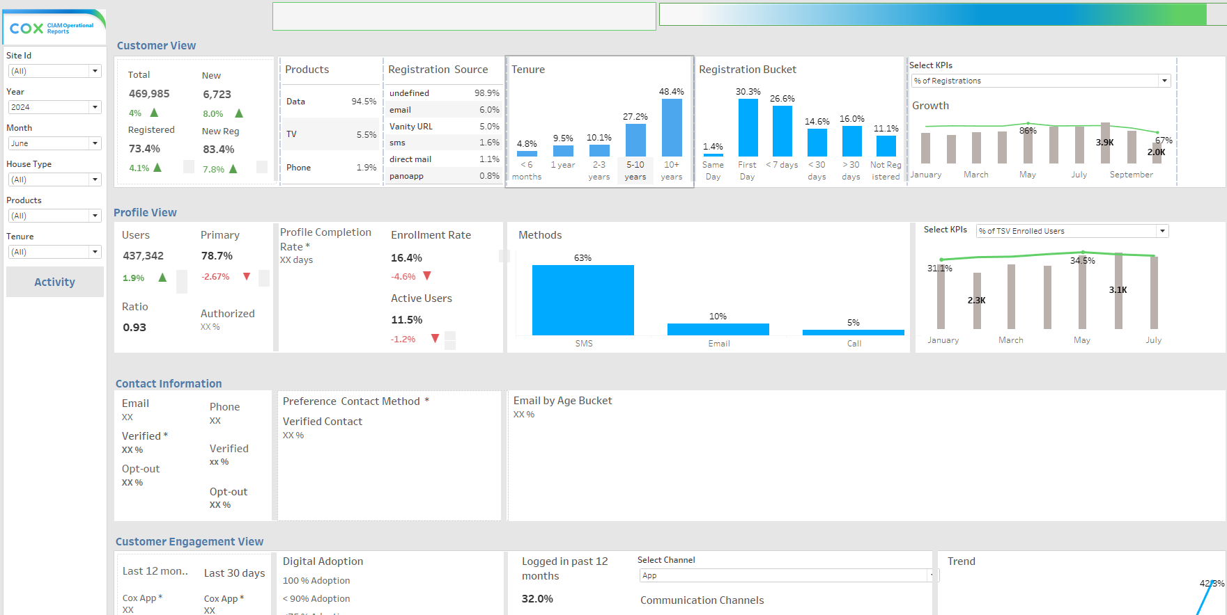
CIAM – Profile Dashboard snapshot (WIP)

Slide 6
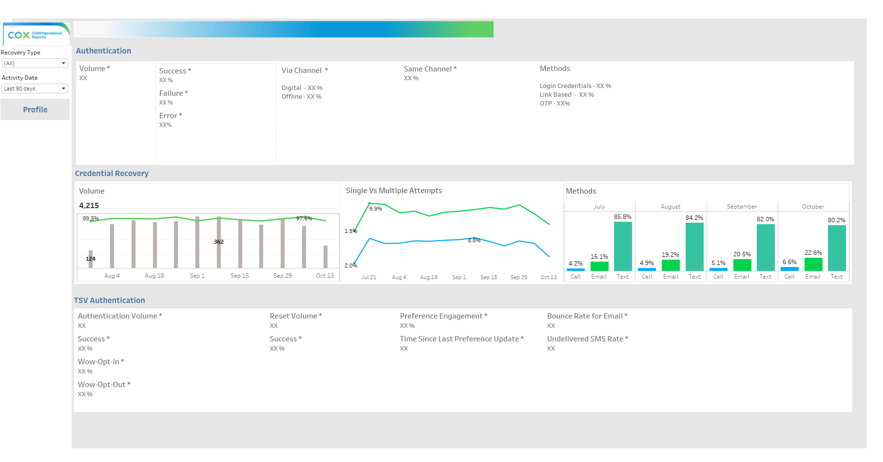
CIAM – Activity Dashboard snapshot (WIP)

Slide 7
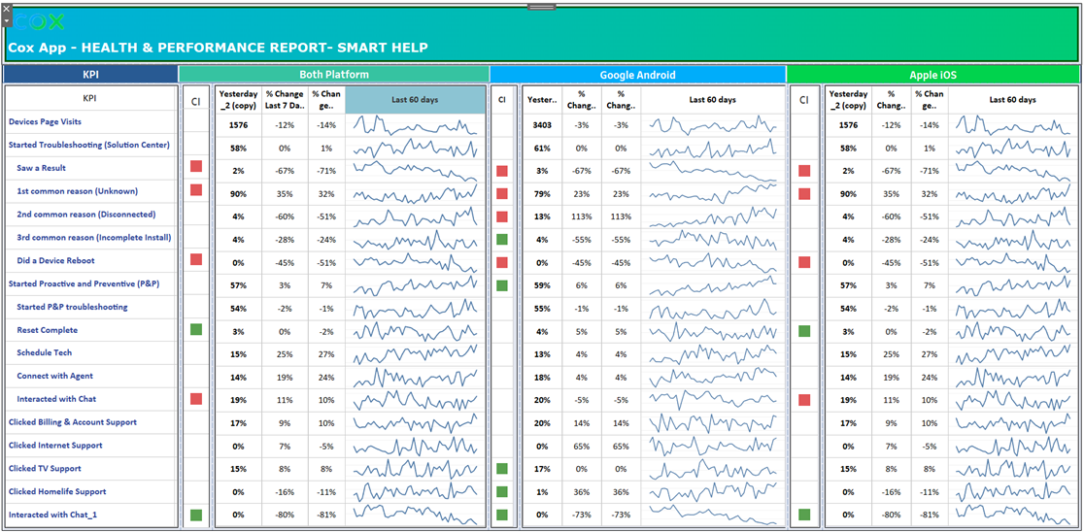
Health Score Card – Dashboard snapshot

Slide 8
Thank You

Slide 9
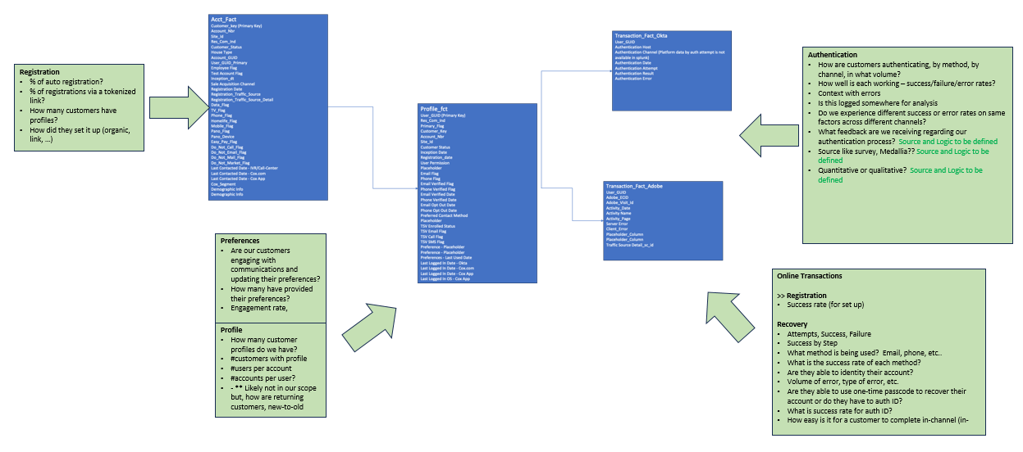
Summary of the CIAM Data Model for BI Reporting

Slide 10
Project Status & Milestones – Data Engineering Track
Data Engineering |  | Progress | Risk Level | Complete Week | Dependencies & Challenges
Activity 1 – Create Fact Tables in Athena [Test/Sample]
 | Account Fact Table & Profile Fact Table |  |  | WE 9th September | Correct Filtering of Data & Field Level Data Validation
 | Transaction Fact Octa Table & Transaction Fact Adobe Table |  |  | WE 16th September
Activity 2 – Upload Fact Tables in S3 - CIAM_DATAMODEL [Test files]
 | Upload Fact Tables to S3 Bucket Storage |  |  | WE 23rd September | Data Transformation & Validation using AWS Quicksights
 | Validation and Transformation of Activity Fact Tables |  |  | Ongoing
Create Partition & Load - External Table in AWS Athena
 | Loading Incremental Data into the External Tables |  |  | WE 25th October | Access may take upto 2-3 weeks may delay these activities
 | Complete data update in all Fact Tables |  |  | WE 25th October
Create Data ETL Pipeline in AWS Glue
 | Create IAM Role for AWS Glue |  |  | WE 29st November | Dependency on Previous Tasks, AWS Glue Access may delay the Timelines
 | AWS Glue Crawler for Data Schema & Metadata Tables |  |  | WE 29st November
Data & Pipeline Testing & Production Deployment |  |  |  | WE 6st December | TBD
Complete
Low
Complete
Low
Complete
Low
WIP
Low
Not started
High
Not started
High
Not started
High
Not started
High
Not started
Medium

Slide 11
Project Status & Milestones – BI & Reporting Track
BI & Reporting Track |  | Progress | Risk Level | Complete Week | Dependencies & Challenges
Activity 1 –Wire Frame/Mock up Design for the Problem Statement
 | Design Mock up Wireframe for Business Agreement |  |  | WE 16th September | Design Validation & Agreement on the Final Wireframe
 | Iterative on the Agreed Design and Functionality |  |  | WE 23rd September
Activity 2 – Map/validate Columns to the Data Model (Fact Tables)
 | Upload Account Fact Table & Profile Fact Table |  |  | WE 18th October | Data Mapping/Validation to Design Wireframe & Transformation Assessment
 | Transaction Fact Octa Table & Transaction Fact Adobe Table |  |  | WE 18th October
Demo & Iterate on the Agreed Design with Actual Data on Tableau
 | Integrate with Data Ingestion through ETL Pieplines |  |  | WE 15st November | Tableau & ETL Implementation & Completion by the Data Team
 | Data Tarnsformation & Design/Report Validation |  |  | WE 15st November
Dashboards Development & Getting Ready for Production
 | Creation of Profile & Activity Dashboards |  |  | WE 29th November | Previous Tasks and Validation & Sign off by the Business Teams
 | Testing of the Dashboards by Dev Team & Production SMEs |  |  | WE 29th November
Dashboards Production Deployment & Training |  |  |  | WE 6th December | TBD
Complete
Low
Complete
Low
Complete
Low
WIP
Low
Not started
High
Not started
High
Not started
High
Not started
High
Not started
Medium

Slide 12
COX - CIAM Data Engg and BI Reporting - Overview
ENGAGEMENT OVERVIEW
Project Vision
Enable Customer Authentication & Track Activity
Data Integration & Transformation
Create Data Staging Layer From Multiple Data Sources
Tableau Based BI Dashboards
Create BI Dashboards
Every customer is enabled to authenticate
Every customer is able to authenticate
Enable View into customer activity & transactions
Access enabled for the AWS DB/Athena
Design & Align on the Data Framework and Models
Integrate Data Queries from Multiple Data Tales
Data and business logic validation
Design ETL Process for the staging layer
Access enabled for the AWS DB/Athena
Design & Align on the BI Framework and Wireframes
Integrate BI with the Data Staging Layer
Validate Data Transformation based on Business Logic
Design Tableau based Dashboards for Business
CURRENT PROGRESS (As Per Original Planned Timeline)
DATA MODELS/FRAMEWORK
BI DASHBOARDS
Overall Project Status
Account & Profile –
Extraction of Fact Tables – Completed
Athena query preparation for Metrics - WIP
Octa/Adobe Activity Fact Tables –
Extraction of Fact Tables – Completed
Cox Validation of Fact Tables – Ongoing
Account & Profile Fact Tables Wireframe – Completed
Account & Profile Fact Tables Dashboard – WIP
Octa/Adobe Activity Fact Tables Dashboards – WIP
Tableau Access & S3 connectivity – WIP ( Manual approach to connect S3 but session disconnect in 8 Hrs.)
AWS complete data set access for eClerx Team – Pending
Excel operation limitation in Cox environment – Delay in data validation
Limited access to Cox S3 data tables making data validation a longer process
Changes to the Lookup Rules post validation leads to iterations on fact tables increasing the timelines
Tableau Access & S3 connectivity - Manual approach to connect S3 but session disconnect in 8 Hrs.
Dependency on the fact tables validation & completion
Project Risk
& Challenges
Ongoing Data & Business Logic Enhancements

Slide 13
Original Project Plan
Activities |  | 12-Aug | 19-Aug | 26-Aug | 2-Sep | 9-Sep | 16-Sep | 23-Sep | 30-Sep | 7-Oct | 14-Oct | 21-Oct | 28-Oct | 4-Nov
Engineering | Individual Accesses & Azure AVD set up
 | Discovery & Requirement Gathering
 | Accesses and Environment Setup (AWS)
 | Build Data Framework
 | Data Validation
 | Data Transformation Flow (ETL)
 | Scheduling and Automation
 | Monitoring
Visualization | Business Goals & Data Sample
 | Design Templates
 | Stakeholder Review
 | Development
 | Validation
 | Stakeholder Review
 | Deployment & Support

Slide 14
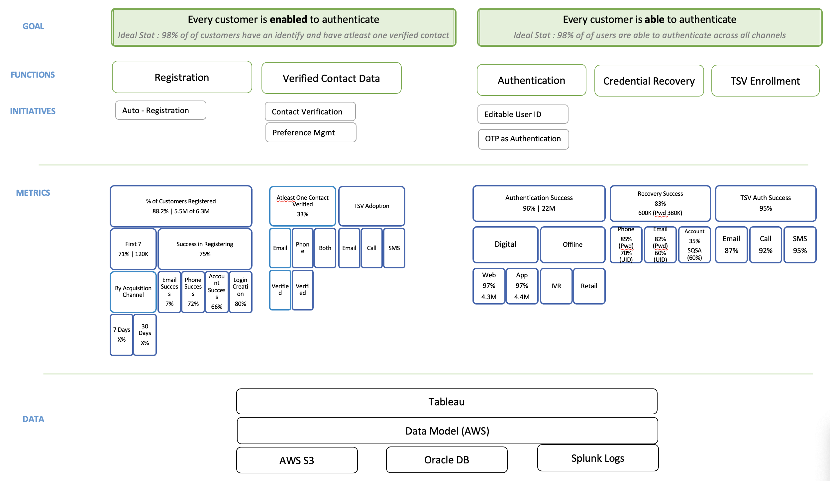
CIAM - Functions, Initiatives and Metrics Mapping (Original)

Slide 15
Summary of the CIAM BI Reporting Metrics
Total Metrics on Dashboard – 67
(14 Metrics WIP)
Profile Tab
Total Metris - 48
Activity Tab
Total Metrics - 19
Sections
Customer - 17
Contact - 6
Profile -11
Activity - 14

